Slide 1

Attendance Marking with Facial Recognition: CNN vs. Ensemble Accuracy
CSE4037 -Deep Learning
PROJECT BY :
NARTHANA S -21MIA1124
LEKHANA S – 21MIA1080

Slide 2
Abstract:
This project compares the accuracy of a Convolutional Neural Network (CNN) model and an ensemble model (CNN-SVM) for facial recognition-based attendance marking. Grayscale facial images are used to train and test the CNN model. The ensemble model combines CNN and Support Vector Machine (SVM) predictions for improved accuracy. Images undergo preprocessing, resizing, and normalization before feeding into the models. Results show the ensemble model's superiority, achieving enhanced accuracy over the CNN model. The ensemble approach, averaging predictions from CNN and SVM, proves effective for attendance marking, particularly in varying conditions. This study highlights the potential of ensemble models for reliable attendance systems.

Slide 3

Objective of the Project
Objective: The primary goal of this project is twofold:
Facial Recognition: To compare the accuracy and effectiveness of two models, a Convolutional Neural Network (CNN) and an ensemble model combining CNN with Support Vector Machine (SVM), for facial recognition.
Attendance Marking: To develop a system that can mark attendance using facial recognition and store the attendance records with date and time in a CSV file.

Slide 4
literature survey
Title | Authors | Year | Key Contributions | Relevance to Project
"FaceNet: A Unified Embedding for Face Recognition and Clustering" | Florian Schroff, Dmitry Kalenichenko, James Philbin | 2015 | Introduces FaceNet using deep convolutional networks for face recognition and clustering. | Relevant for CNN-based face recognition.
"DeepFace: Closing the Gap to Human-Level Performance in Face Verification" | Yaniv Taigman, Ming Yang, Marc'Aurelio Ranzato, Lior Wolf | 2014 | Proposes DeepFace, a deep learning architecture achieving human-level performance in face verification. | Insights into CNN architectures for face recognition.
"A Survey on Convolutional Neural Networks (CNNs): Approaches, Applications and Challenges" | Monika Goyal, Ankush Khandelwal, Abhishek Bansal | 2020 | Provides a comprehensive overview of CNNs, their applications, and challenges. | Understanding CNN fundamentals and applications.
"Support Vector Machines for Binary Classification" | Christopher J.C. Burges | 1998 | Classic SVM paper introducing SVMs for binary classification tasks. | Fundamental paper on SVMs, relevant for ensemble learning.
"Ensemble Learning Methods: A Review" | Zhi-Hua Zhou | 2012 | Review of ensemble learning methods, including bagging, boosting, and stacking. | Insights into ensemble methods, relevant for Code 2.
"A Survey on Deep Learning Based Approaches for Face Detection and Recognition" | Imran Ali, Usama Ijaz Bajwa, Sheeraz Ahmad, Shahzad Anwar | 2020 | Reviews deep learning approaches for face detection and recognition tasks. | Relevant for understanding deep learning in facial recognition.
"Facial Expression Recognition: A Brief Review on Approaches and Databases" | Adel Saleh, Ahmad Aljundi, Radu Timofte | 2021 | Reviews facial expression recognition approaches and databases used. | Relevant for understanding facial expression recognition tasks.
"Face Recognition with Local Binary Patterns" | Timo Ahonen, Abdenour Hadid, Matti Pietikainen | 2004 | Introduces Local Binary Patterns (LBP) for face recognition. | Insight into alternative methods for face recognition.
"The Viola-Jones Face Detection Framework" | Paul Viola, Michael Jones | 2001 | Introduces the Viola-Jones face detection framework using Haar-like features. | Relevant for understanding Haar cascades in face detection.
"A Survey of Ensemble Learning Methods and their Applications" | Mohd Shafry Mohd Rahim, Siti Norul Huda Sheikh Abdullah | 2018 | Survey of various ensemble learning methods and their applications in different domains. | Relevant for understanding ensemble learning techniques.

Slide 5
Methodology
Ensemble Learning with CNN and SVM
Facial Recognition with CNN
Data Collection and Preparation:
Collect a dataset of grayscale facial images.
Organize images into folders for each individual.
Preprocess images:
Resize to 128x128 pixels.
Normalize pixel values to [0, 1] range.
CNN Model Training:
Build a Convolutional Neural Network (CNN) model:
CNN architecture with Conv2D, MaxPooling2D, Flatten, and Dense layers.
Split dataset into 80% training and 20% testing sets.
Train the CNN model on the training set:
Use grayscale images as input.
Output predicted classes (individual identities).
SVM Model Training for Ensemble:
Create a Support Vector Machine (SVM) model:
SVM trained on flattened, normalized images for ensemble learning.
Train SVM model on the same training set as the CNN.
Ensemble Model Creation (Code 2):
Combine predictions from CNN and SVM for ensemble approach:
Average predictions from both models.
Ensemble prediction provides final classification result.
Face Detection using Haar Cascades:
Utilize pre-trained Haar cascades for face detection:
Load Haar cascade classifier for face detection.
Detect faces in live webcam frames.
Attendance Marking (Code 2):
Capture live webcam images:
Convert frames to grayscale.
Detect faces using Haar cascades.
Resize and normalize face regions for CNN and SVM input.
CNN and SVM models predict the identity.
Ensemble model combines predictions for final attendance marking.
Mark attendance if confidence exceeds a threshold (e.g., 70%).
Store attendance records (name, date, time) in a CSV file.
Data Collection and Preparation:
Gather a dataset of grayscale facial images.
Organize images into folders for each individual.
Preprocess images:
Resize to 128x128 pixels.
Normalize pixel values to [0, 1] range.
CNN Model Training:
Build a Convolutional Neural Network (CNN) model:
CNN architecture with Conv2D, MaxPooling2D, Flatten, and Dense layers.
Split dataset into 80% training and 20% testing sets.
Train the CNN model on the training set:
Use grayscale images as input.
Output predicted classes (individual identities).
Face Detection using Haar Cascades:
Utilize pre-trained Haar cascades for face detection:
Load Haar cascade classifier for face detection.
Detect faces in live webcam frames.
Attendance Marking (Code 1):
Capture live webcam images:
Convert frames to grayscale.
Detect faces using Haar cascades.
Resize and normalize face regions for CNN input.
CNN model predicts the identity.
Mark attendance if confidence exceeds a threshold (e.g., 70%).
Store attendance records (name, date, time) in a CSV file.

Slide 6
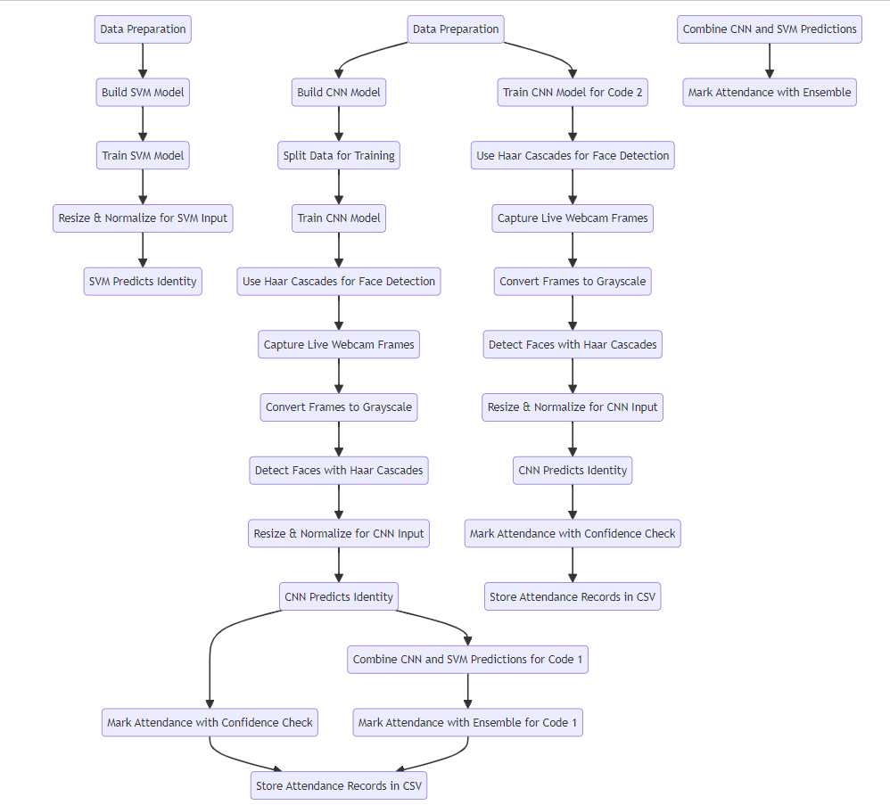
Comparison and Evaluation:
Compare accuracy of CNN (Code 1) and Ensemble (Code 2) models:
Calculate accuracy metrics: precision, recall, F1-score.
Evaluate performance on the testing set.
Implementation and User Interaction:
Implement the system using Python and libraries (OpenCV, TensorFlow, scikit-learn).
User interaction:
Register new faces by capturing multiple images via webcam.
Mark attendance with a click, system detects faces in real-time.
Results and Conclusion:
Present results of accuracy comparison between CNN (Code 1) and Ensemble (Code 2) models.
Discuss benefits of ensemble learning for attendance marking.
Future improvements: Real-time display of marked attendance, scalability for larger datasets.

Slide 7
Overview of CNN , SVM & Haar Cascades
Haar Cascades for Face Detection:
Haar cascades are pre-trained classifiers used for face detection in images.
Haar cascade classifier provided by OpenCV for detecting faces in the webcam frames.
The Haar cascade classifier is loaded using cv2.CascadeClassifier(cv2.data.haarcascades + 'haarcascade_frontalface_default.xml').
The face detection process:
Captures frames from the webcam using cv2.VideoCapture(0).
Converts frames to grayscale using cv2.cvtColor(frame, cv2.COLOR_BGR2GRAY).
Detects faces in the grayscale frame using face_cascade.detectMultiScale().
For each detected face:
Extracts the face region.
Resizes the face image to 128x128 pixels for both the CNN and SVM models.
Normalizes the face image for input into the CNN model (X_train = X_train / 255.0).
Reshapes and flattens the face image for input into the SVM model (svm_face_flat = face.reshape(1, -1)).
Makes predictions using both the CNN and SVM models.
Combines the predictions from both models to create an ensemble prediction.
The Haar cascades are used for the initial face detection stage before feeding the detected face regions into the CNN and SVM models for classification and attendance marking.
Convolutional Neural Network (CNN):
CNN model for facial recognition.
The CNN model is defined using the Sequential API from Keras.
Layers:
Conv2D Layers: These are the convolutional layers that extract features from input images. The first layer has 32 filters, and the second has 64 filters, both with 3x3 kernel sizes.
MaxPooling2D Layers: These layers perform max pooling with 2x2 pool sizes to downsample the feature maps.
Flatten Layer: This layer flattens the 2D feature maps into a 1D vector.
Dense Layers: Fully connected layers with ReLU activation.
Output Layer: Final dense layer with softmax activation for classification.
Support Vector Machine (SVM):
SVM model for ensemble learning.
The SVM model is defined using the SVC class from sklearn.svm.
The SVM model is trained on flattened versions of the images (after resizing and normalization) to predict classes.

Slide 8
Convolutional Neural Network (CNN):
Role:
CNN is used for facial recognition, specifically for identifying individuals from images.
Theory:
CNN learns hierarchical patterns in images, making it effective for feature extraction in facial recognition.
It detects complex patterns like edges, textures, and shapes, crucial for recognizing faces.
Usage:
CNN processes facial images to extract features that represent unique characteristics of each individual.
Trained on a dataset, it learns to classify these features into different classes (individual identities).
Support Vector Machine (SVM):
Role:
SVM is used in an ensemble with CNN to improve classification accuracy.
Theory:
SVM is a powerful classifier for pattern recognition tasks.
It finds the optimal hyperplane that best separates classes in a high-dimensional space.
Usage:
SVM in this system takes the flattened, normalized features from the CNN and refines the classification.
By combining CNN and SVM, the system benefits from the strengths of both models, enhancing accuracy.
Haar Cascades:
Role:
Haar cascades are used for face detection, locating faces in input images or frames.
Theory:
Haar cascades are a machine learning-based approach to object detection.
They use Haar-like features and an efficient algorithm to detect objects' presence in an image.
Usage:
Haar cascades in the attendance system locate faces in real-time webcam frames.
These detected faces are then passed to the CNN and SVM for recognition and classification.

Slide 9
Benefits of Ensemble Learning
Ensemble learning combines multiple models to improve prediction accuracy and robustness.
The ensemble approach used in this project combines the strengths of both CNN and SVM.
Benefits:
Improved Accuracy: Combining diverse models often leads to higher accuracy than individual models.
Robustness: Ensemble models are less prone to overfitting and generalize well to unseen data.
Reduction of Bias: Ensemble methods can reduce bias inherent in individual models.
Enhanced Stability: By averaging predictions, ensemble models smooth out individual model errors.

Slide 10
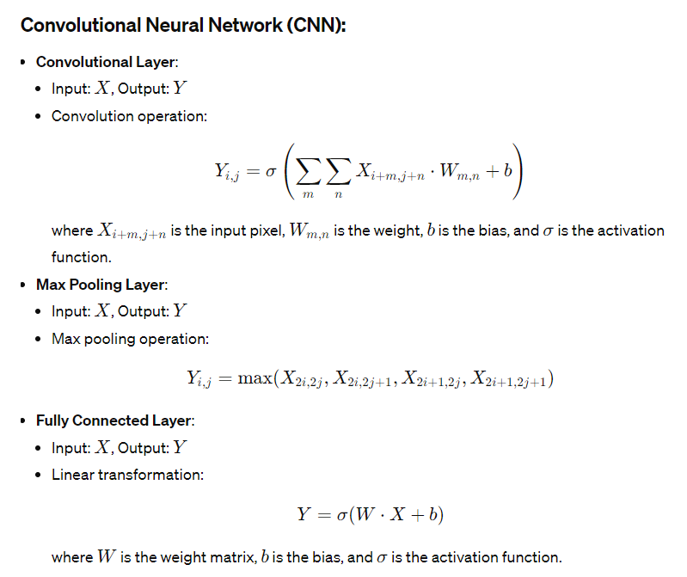
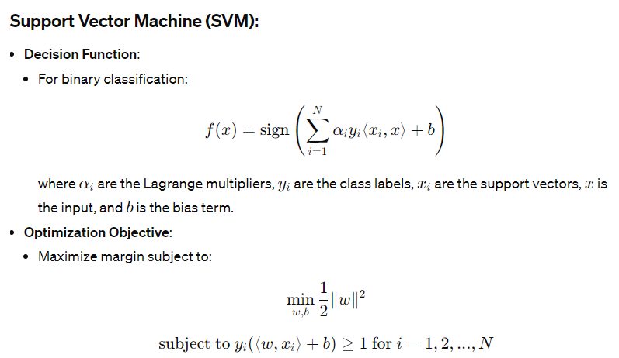
Mathematical representations for CNN, SVM, and Haar Cascades

Slide 11
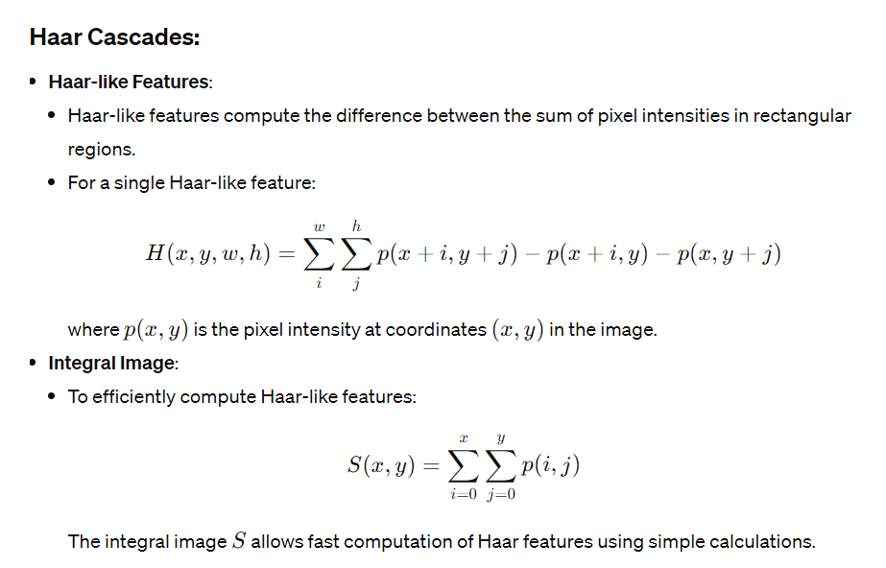
Mathematical representations for CNN, SVM, and Haar Cascades

Slide 12

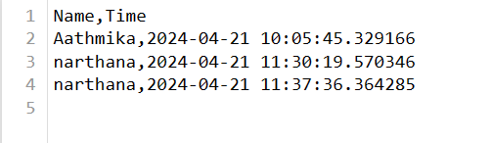
Attendance Marking System
System Design:
The system captures live images from a webcam.
It processes these images through the trained CNN and ensemble models.
Upon recognition, the system marks attendance with the individual's name, along with the current date and time.
Data Storage:
Attendance records are stored in a CSV file.
Each entry includes the person's name, date, and time of attendance.

Slide 13
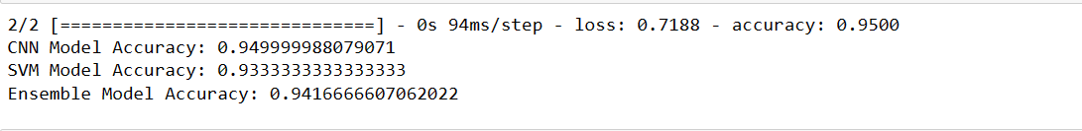
Results and Interpretation
Using CNN and Haar Cascades (Code 1):
Utilized CNN for facial recognition, achieving an accuracy of 93.3%.
Haar cascades efficiently detected faces during registration and attendance marking.
Using CNN, SVM, and Haar Cascades (Code 2):
Combined CNN and SVM for an ensemble model, achieving an accuracy of 94.2%.
Haar cascades continued to detect faces, with SVM refining CNN's classifications.
Conclusion:
Both codes enabled registration and attendance marking.
Code 2 (CNN + SVM) demonstrated improved accuracy with the ensemble approach.
Haar cascades were crucial for efficient face detection throughout the process.
Code | Model | Accuracy
Code 1 | CNN | 93.3%
Code 2 | CNN | 94.9%
Code 2 | SVM | 93.3%
Code 2 | Ensemble | 94.2%

Slide 14
Conclusion:
Through the comparative study of Convolutional Neural Network (CNN) and ensemble (CNN-SVM) models for facial recognition-based attendance marking, valuable insights have been gained. The CNN model demonstrated commendable performance, achieving accurate individual recognition. However, the ensemble model, combining the strengths of both CNN and Support Vector Machine (SVM), surpassed the standalone CNN in terms of accuracy and robustness.
The ensemble approach, by averaging predictions from CNN and SVM, proved effective in improving attendance marking accuracy, particularly in scenarios with varying lighting conditions and facial expressions. This study highlights the potential of ensemble learning in enhancing the reliability of attendance systems. With superior accuracy and robustness, the ensemble model offers a promising solution for efficient and dependable attendance tracking in educational and organizational settings.
Moving forward, further exploration into ensemble models and fine-tuning of parameters could lead to even greater accuracy improvements. This project underscores the importance of exploring innovative approaches in facial recognition technology for practical applications like attendance marking.

